Slide 1


Getting Started With
Microsoft Access
Database
3
Manager of Information Center
Tendering Department
Arab Contractors
Said Fawzy

Slide 2
Getting Started With
Microsoft Access
Database
3
Entity Relationship Diagram ERD
Manager of Information Center
Tendering Department
Arab Contractors
Said Fawzy

Slide 3


Contents
Task 3: Create ERD
Task4: Define Relationships
Activity1:Create Your own ERD.
Relationship
Entity Relationship Modeling (ERD)
Activity2: Define your relationship.

Slide 4
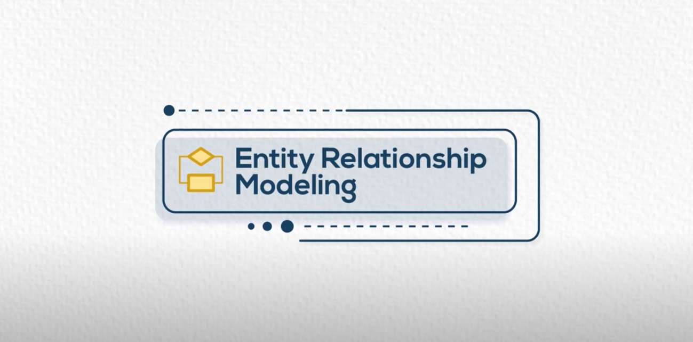

Slide 5
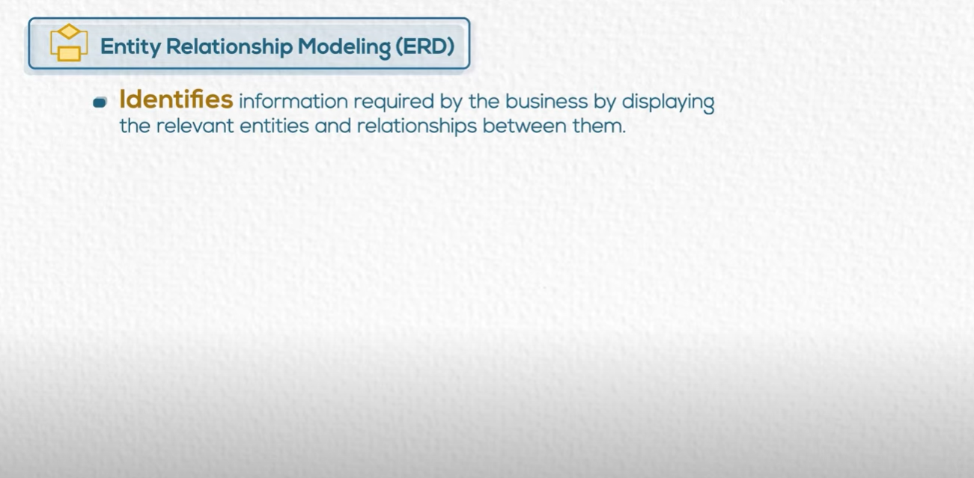

Slide 6
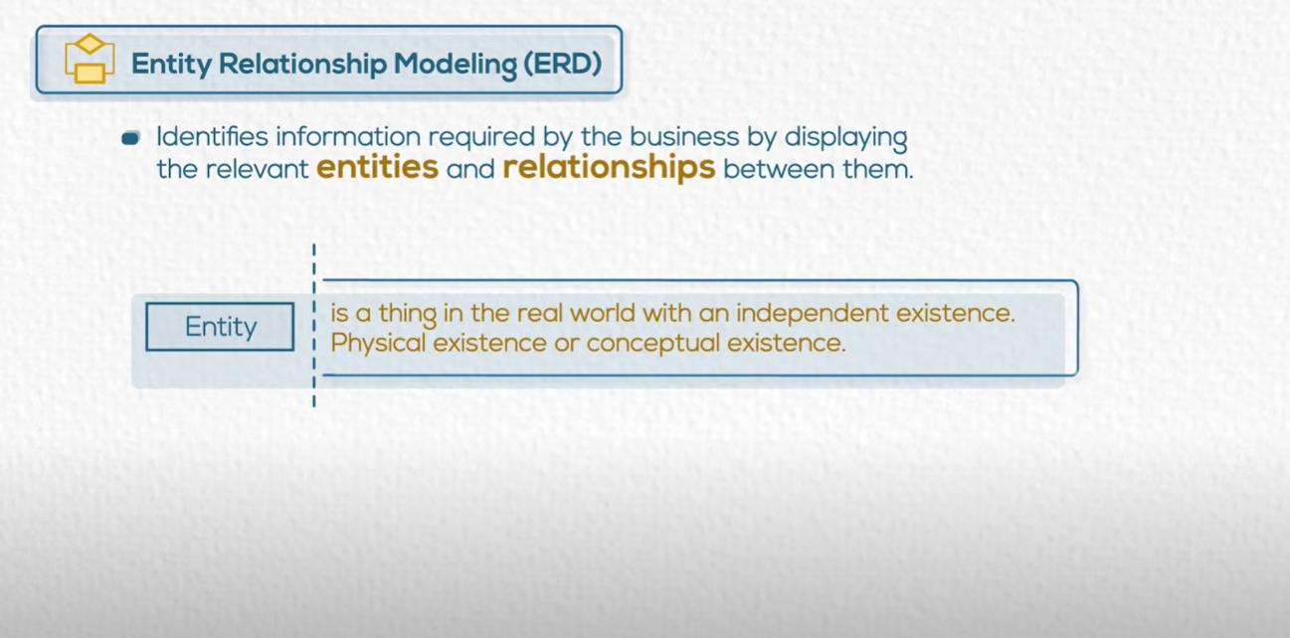

Slide 7
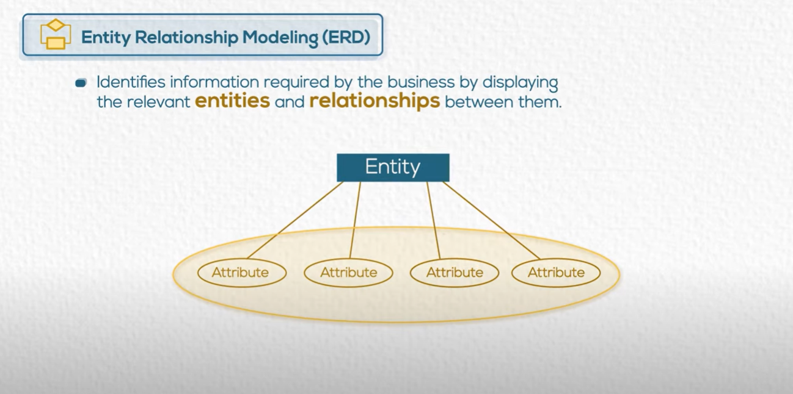

Slide 8
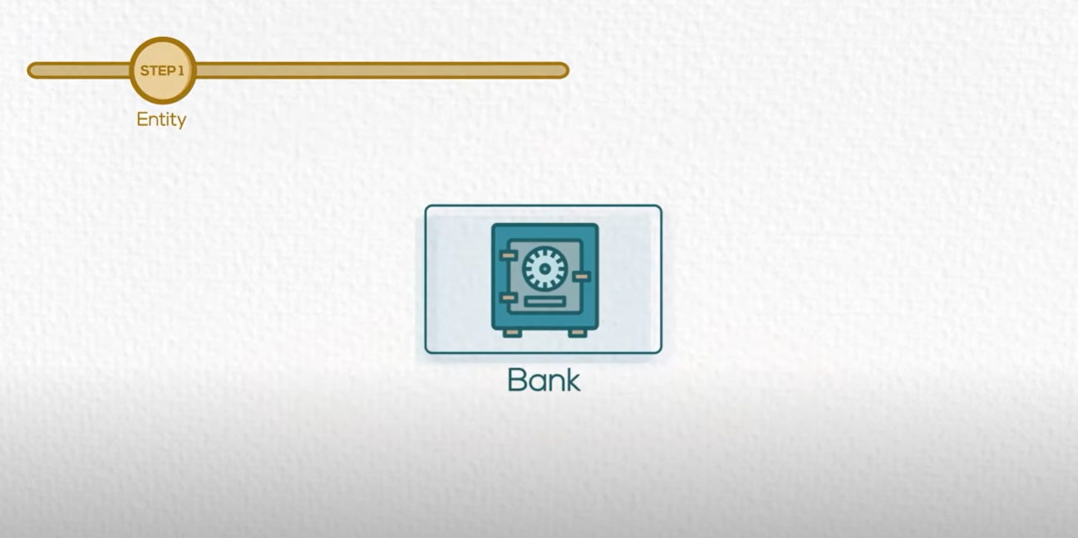

Slide 9
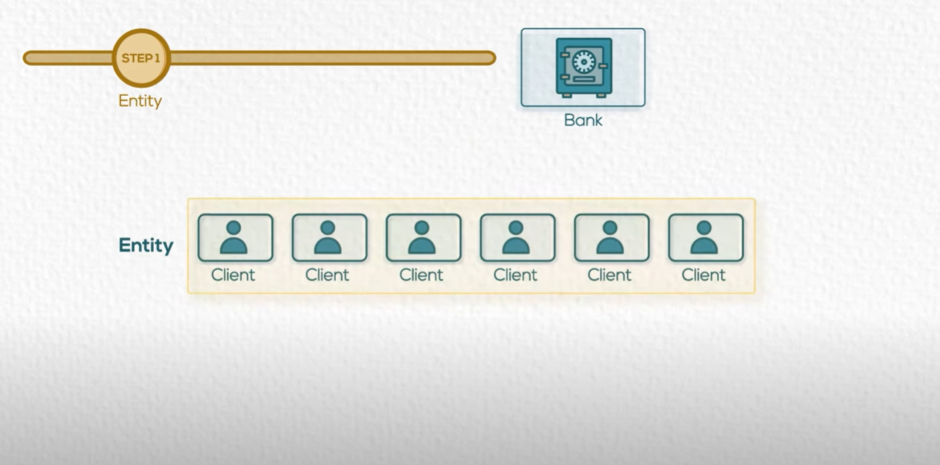

Slide 10
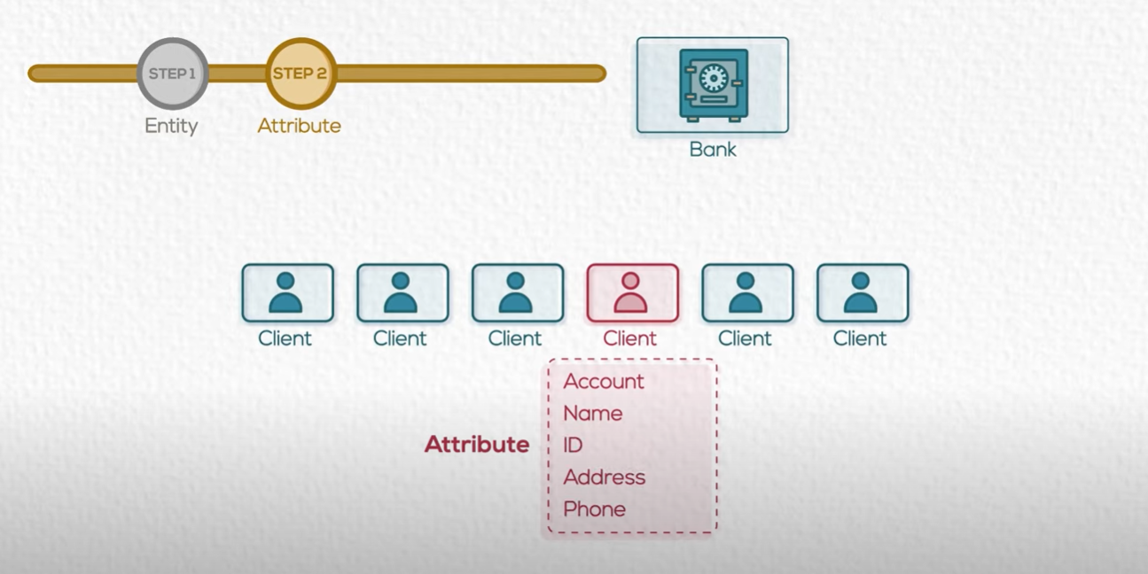

Slide 11


Slide 12
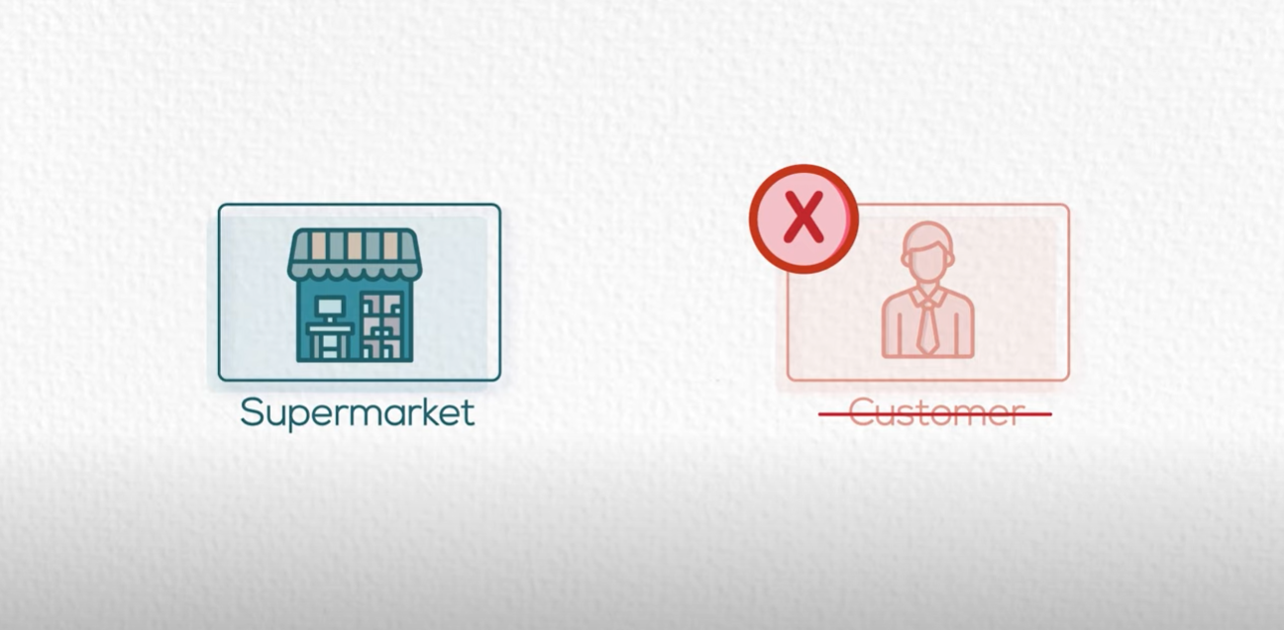

Slide 13


Training Center

Slide 14
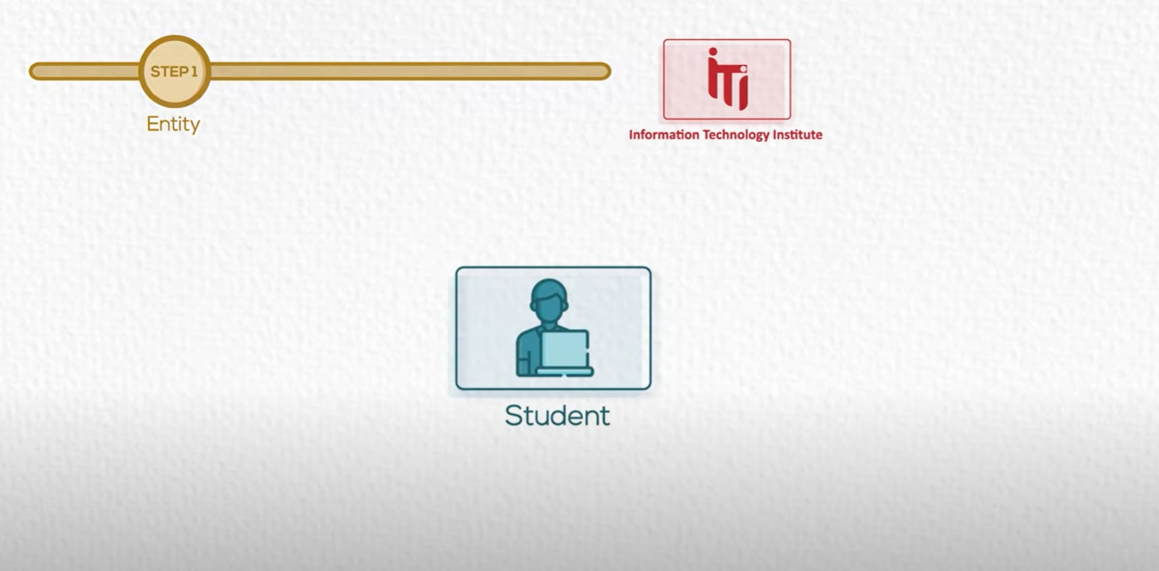




Slide 15
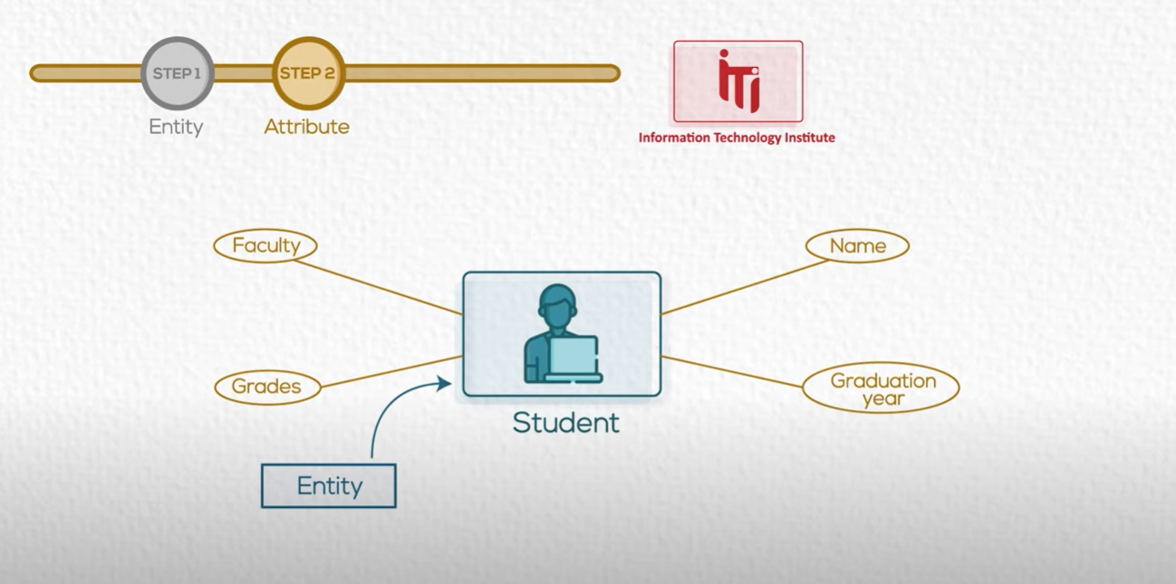

Slide 16
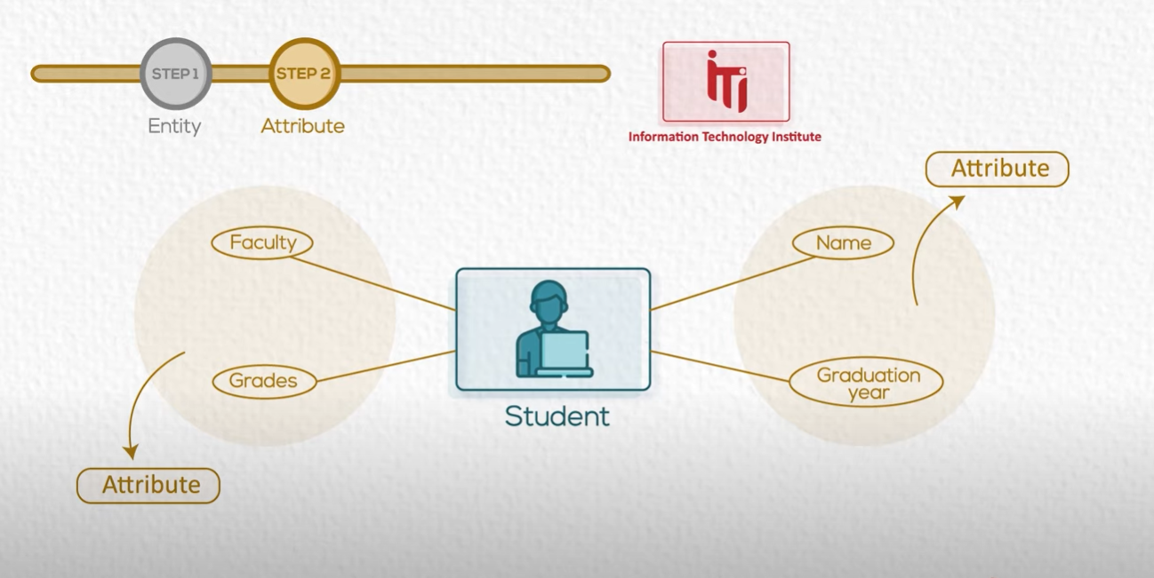

Slide 17
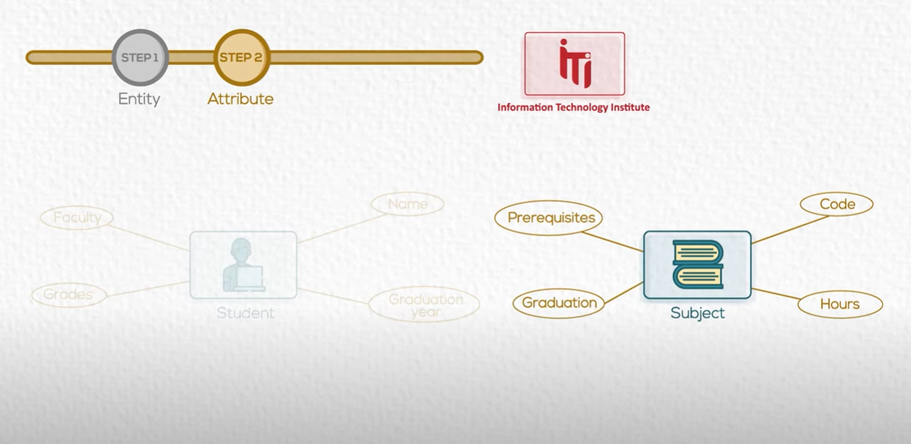

Slide 18
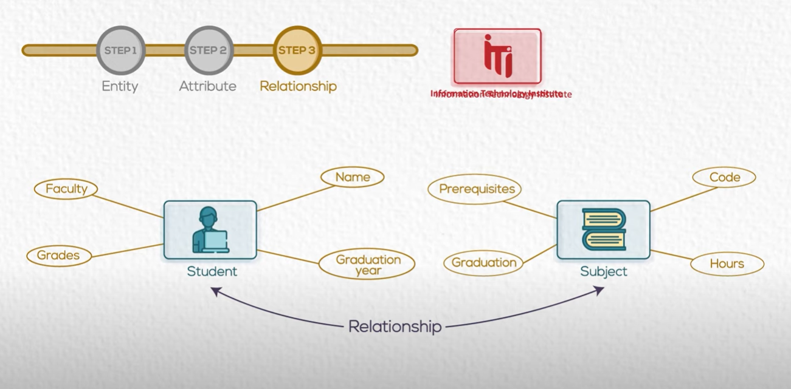

Slide 19
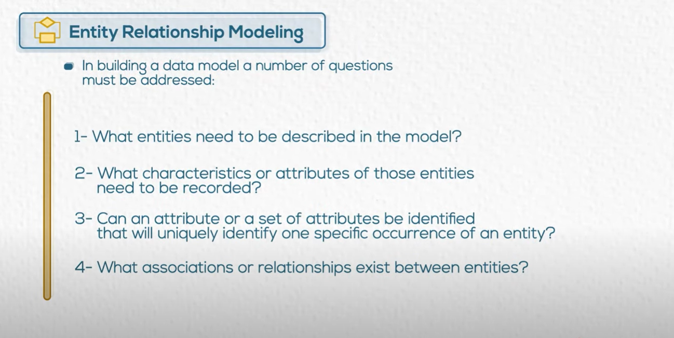

Slide 20
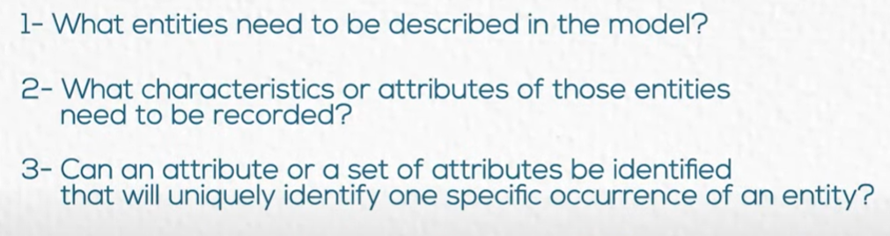
Task 3: Create ERD
We need to Create ERD for Company Database.
We will Apply the 3 first steps of the Guide:

Slide 21

Dept
Emp
Contact
Project
Car
Dependent
Skill

Slide 22
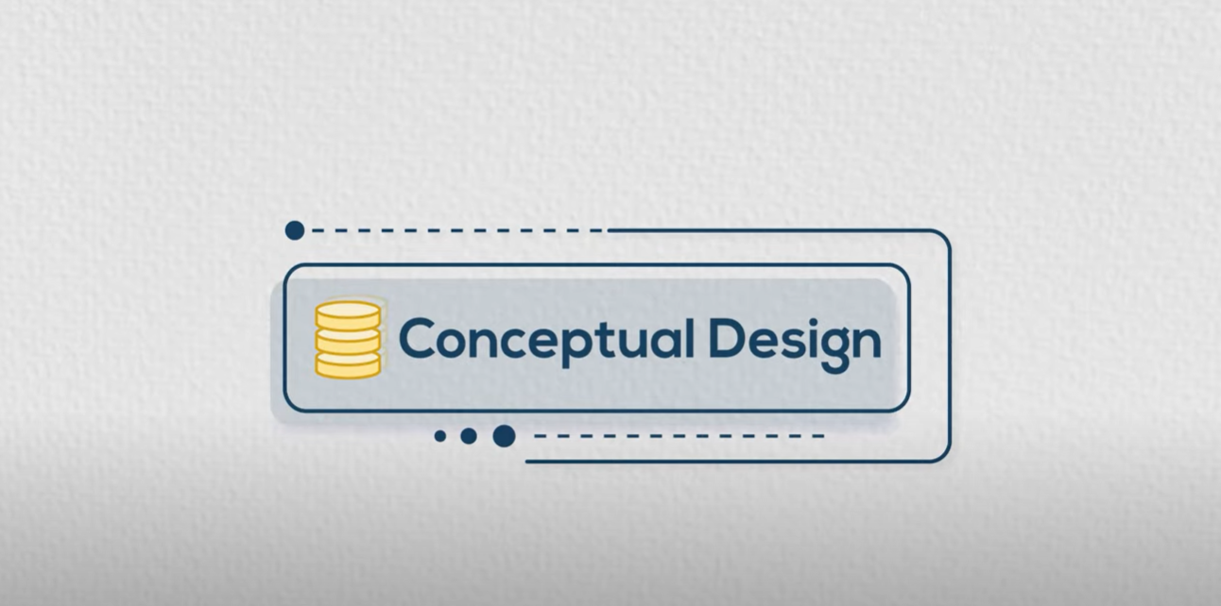

Slide 23
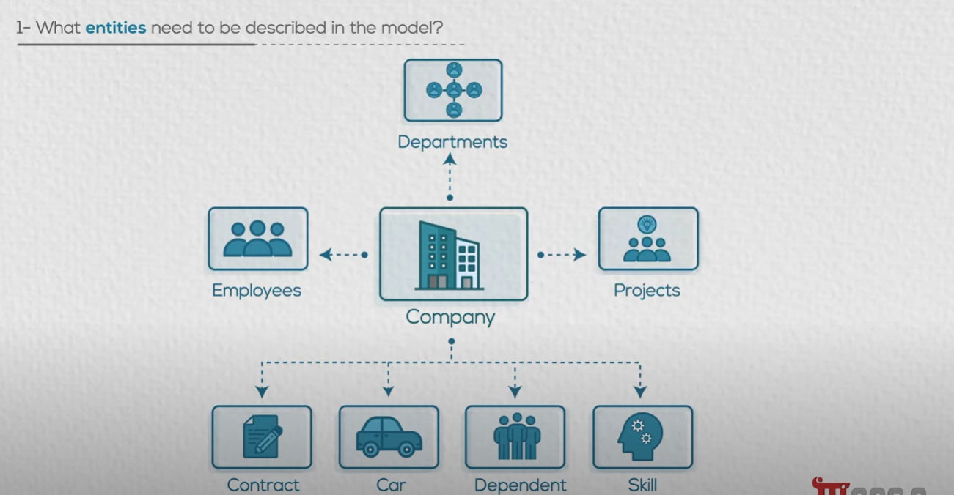


Slide 24
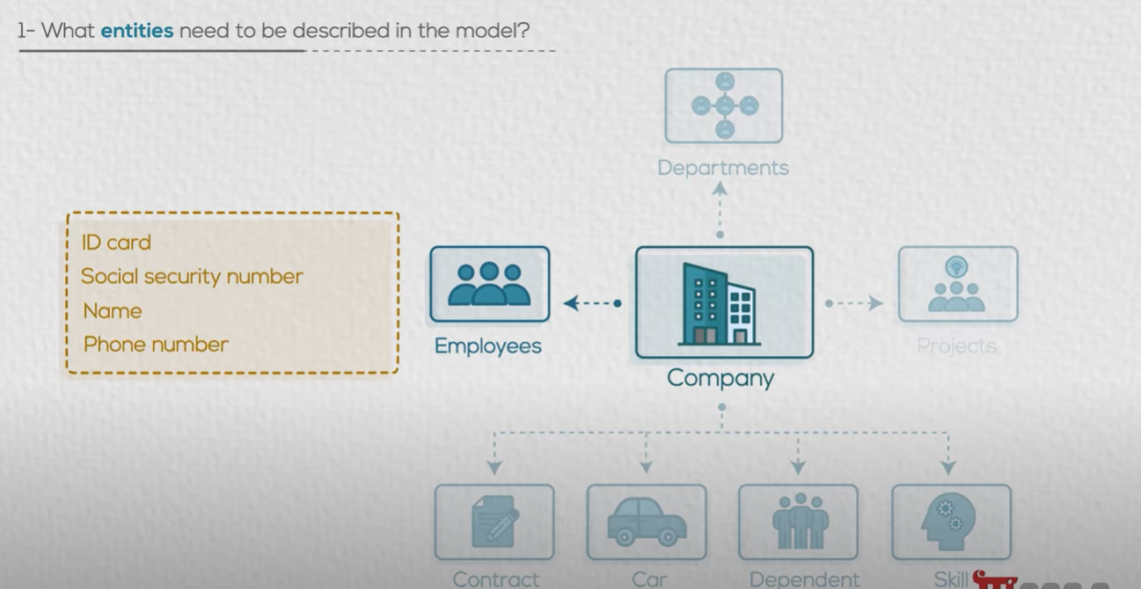

Slide 25
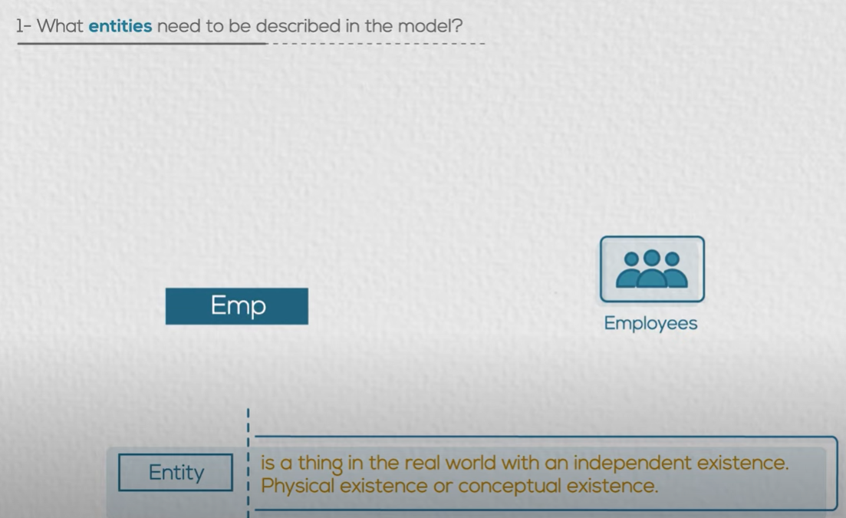

Slide 26
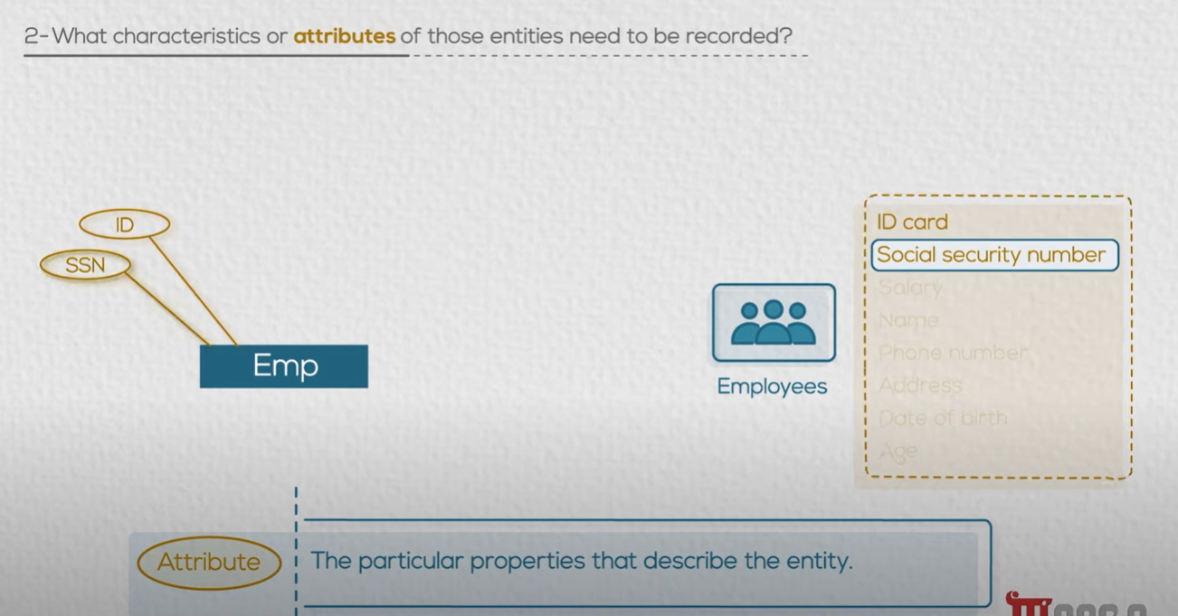
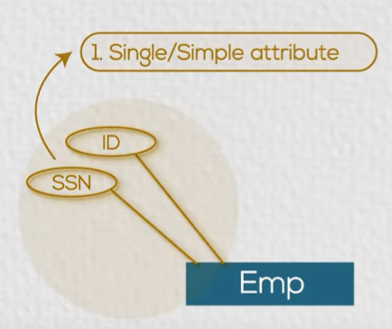

Slide 27
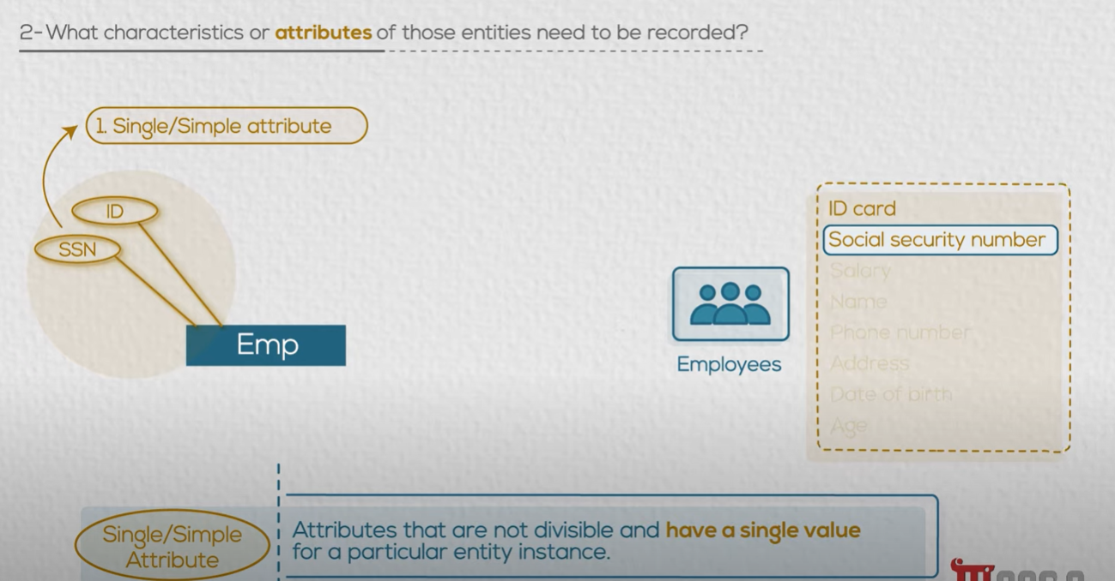

Slide 28
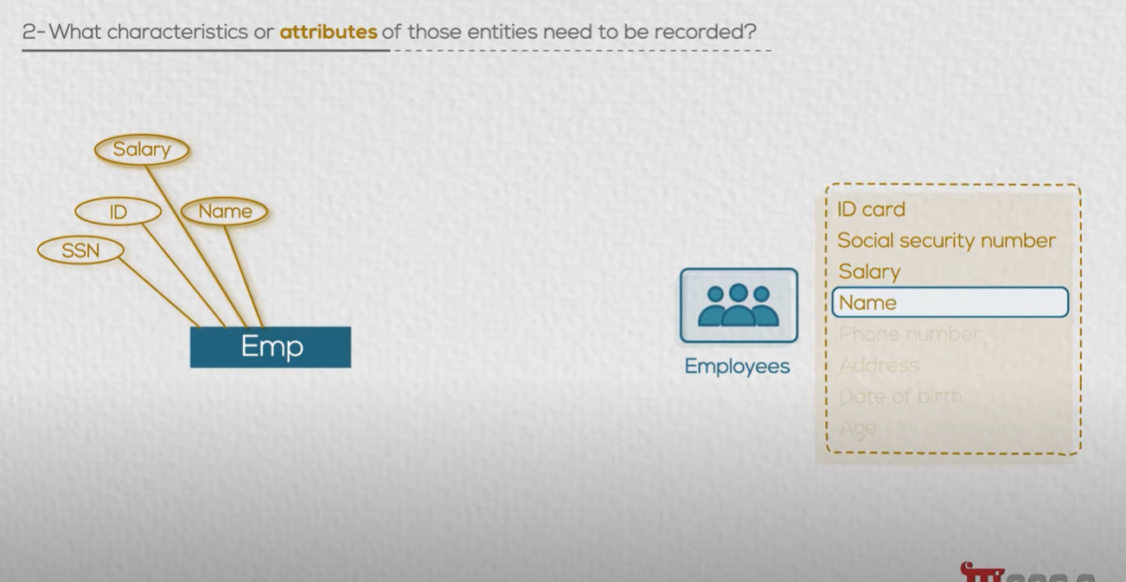

Slide 29
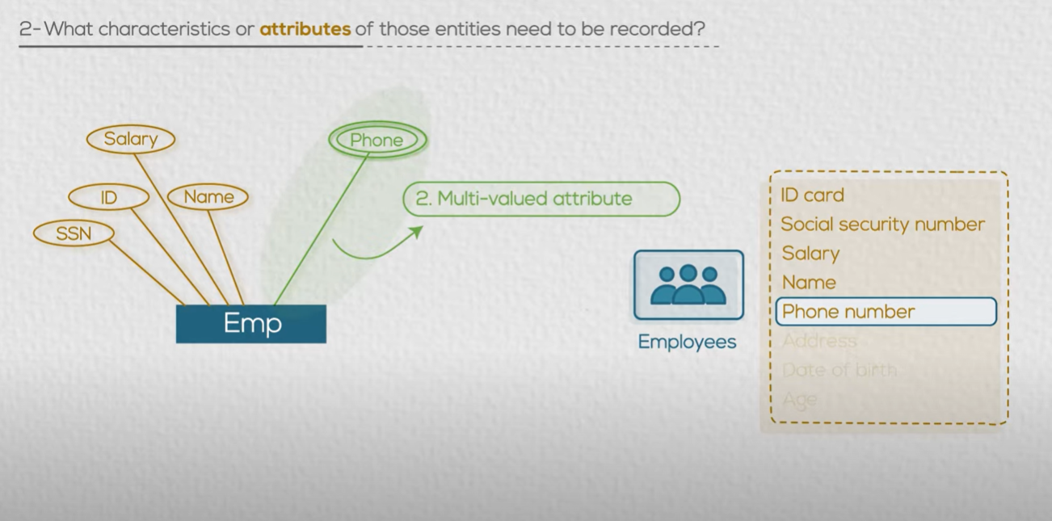

Slide 30
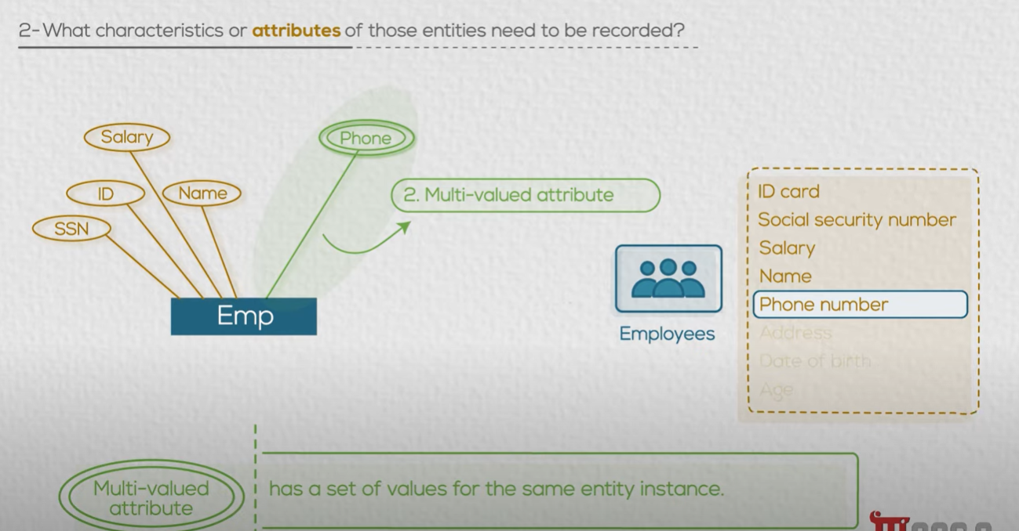

Slide 31
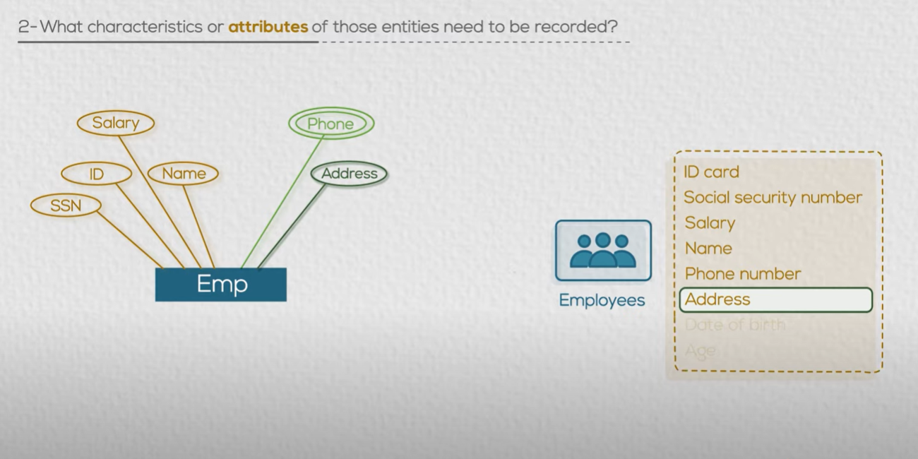

Slide 32
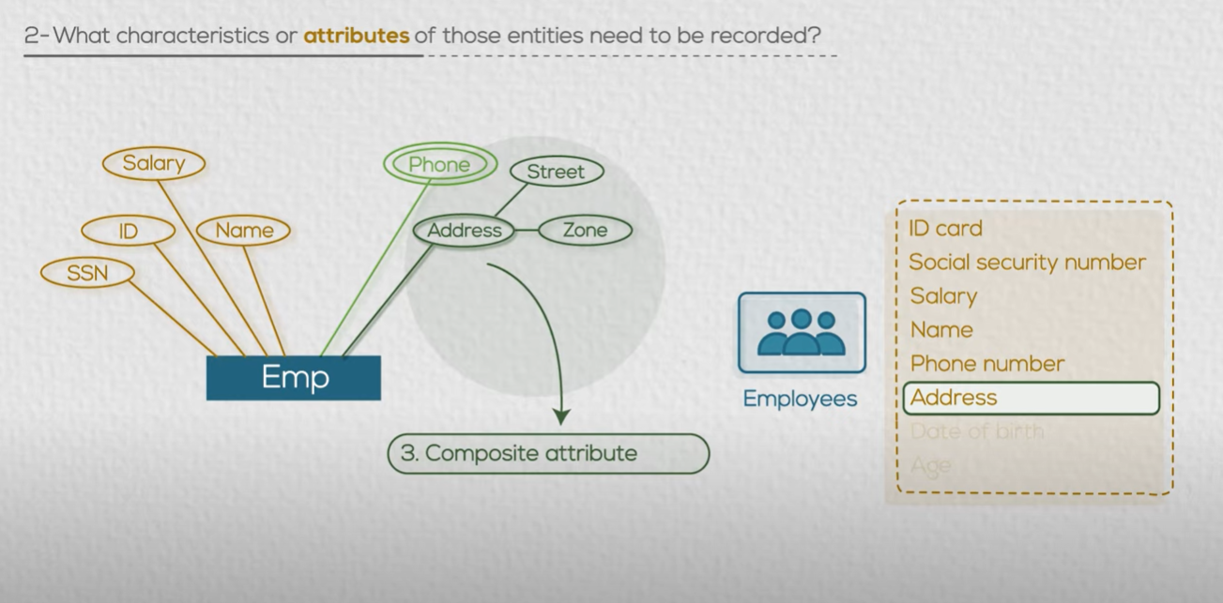

Slide 33
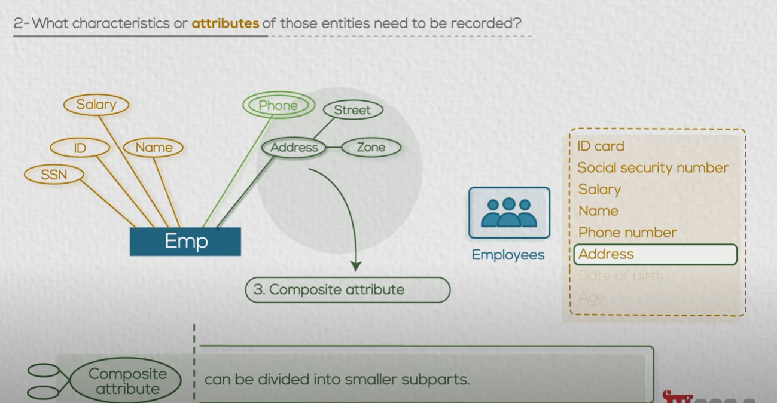

Slide 34
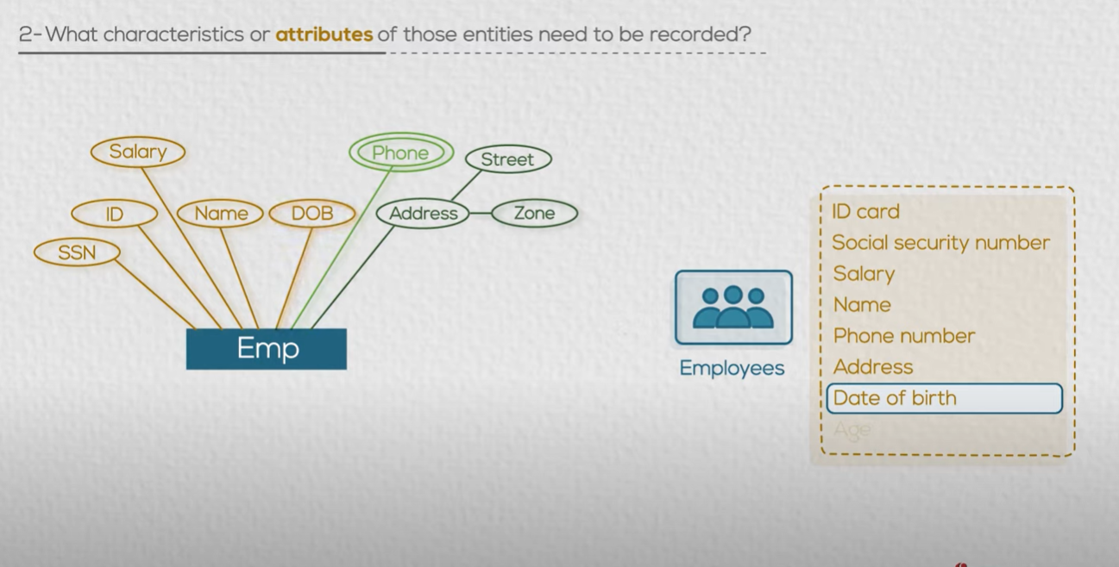

Slide 35
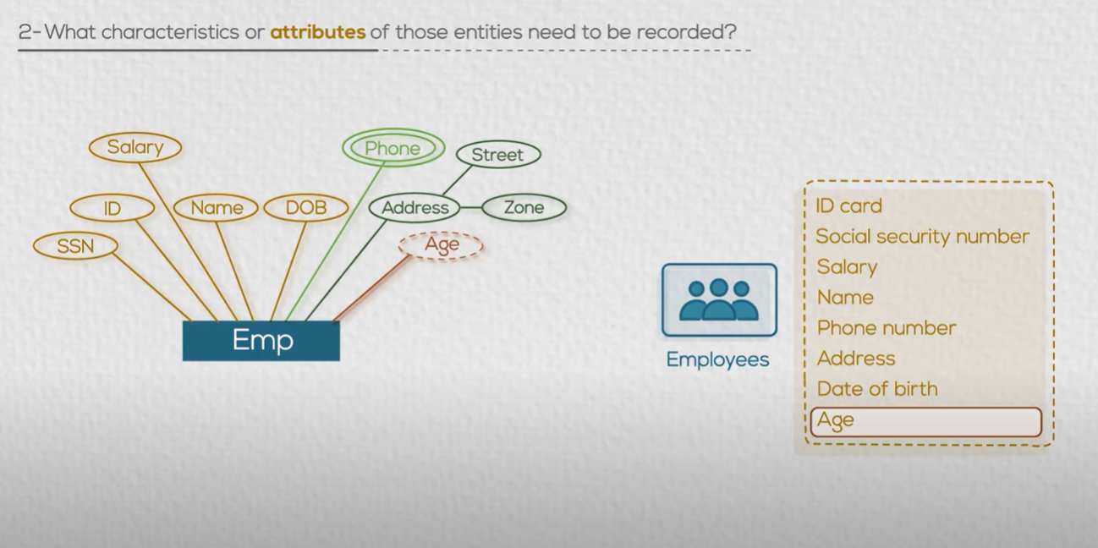

Slide 36
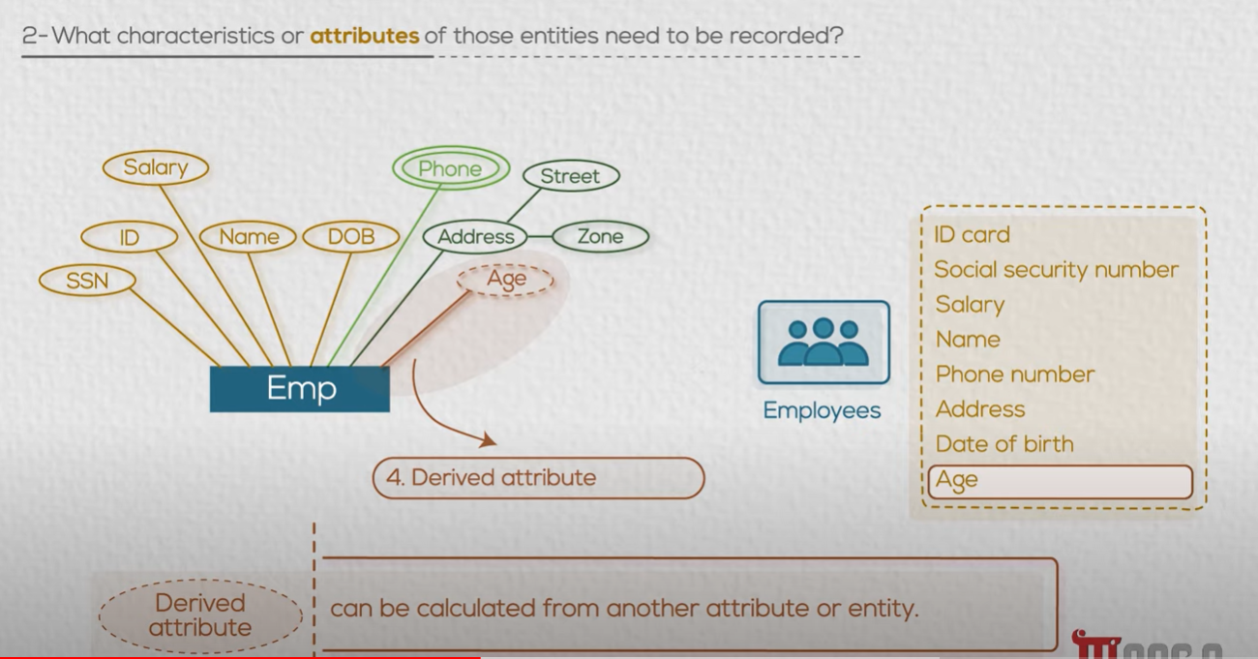

Slide 37
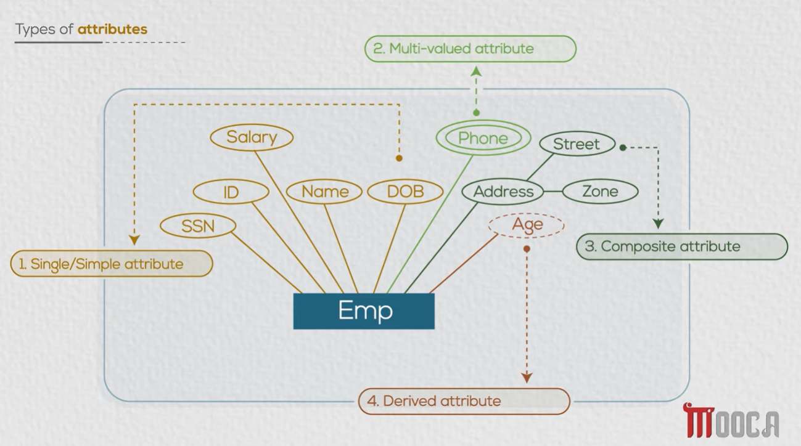

Slide 38
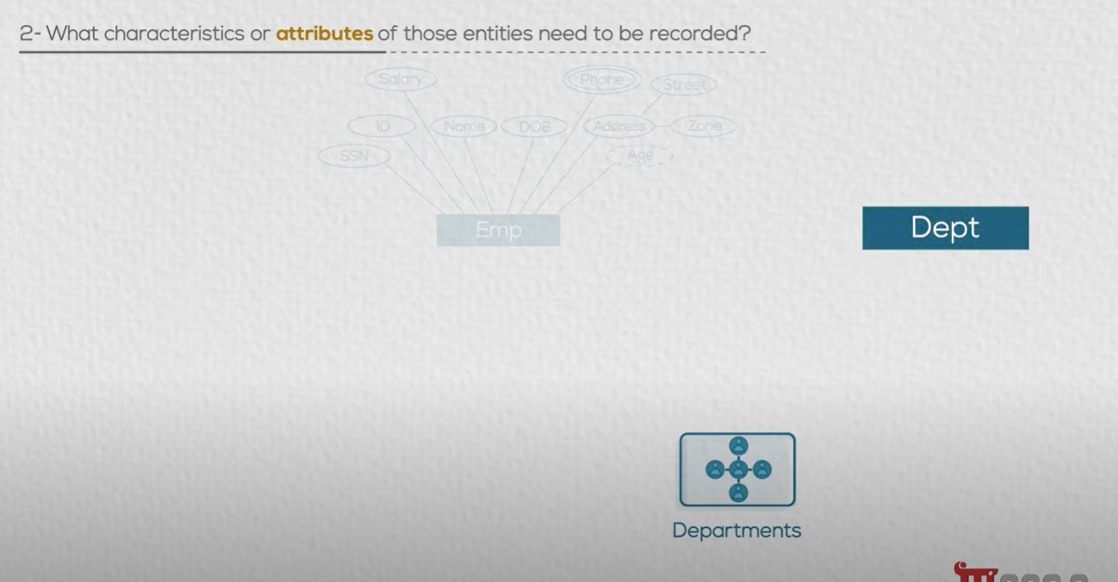

Slide 39
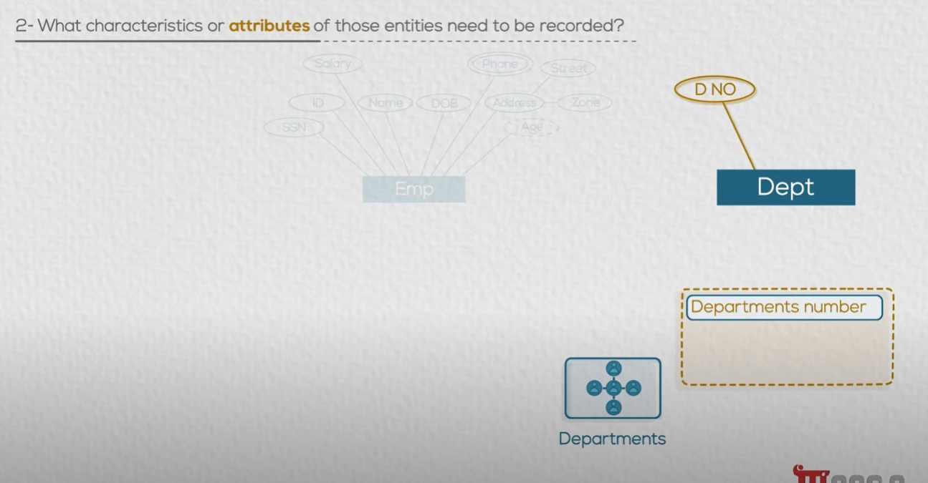

Slide 40
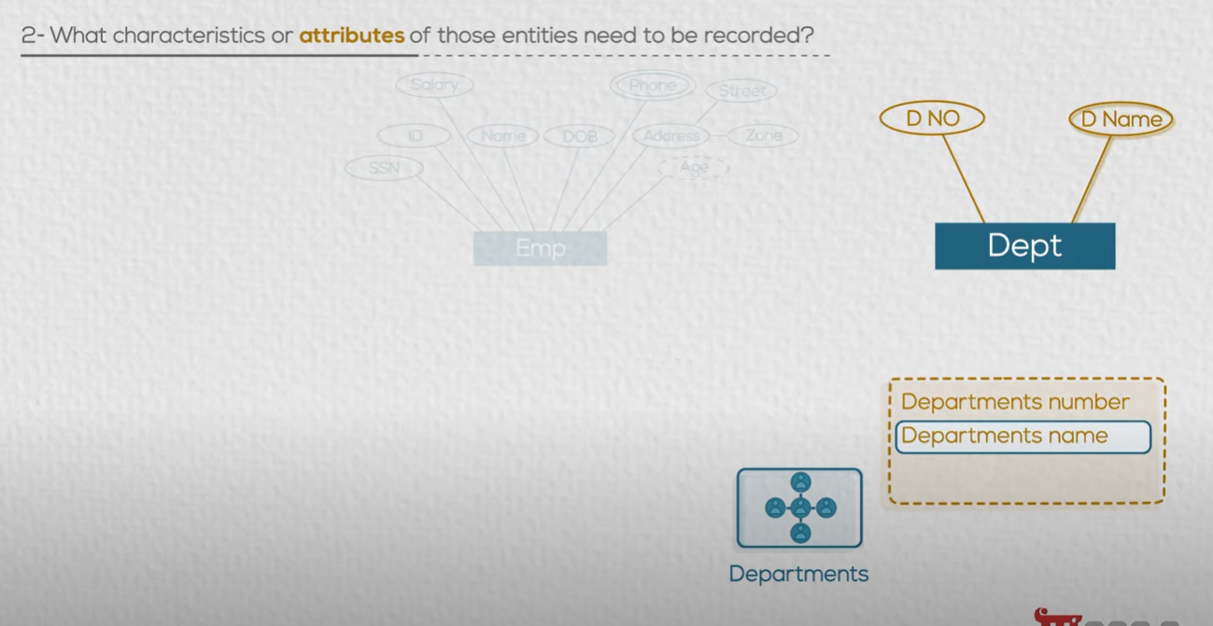

Slide 41
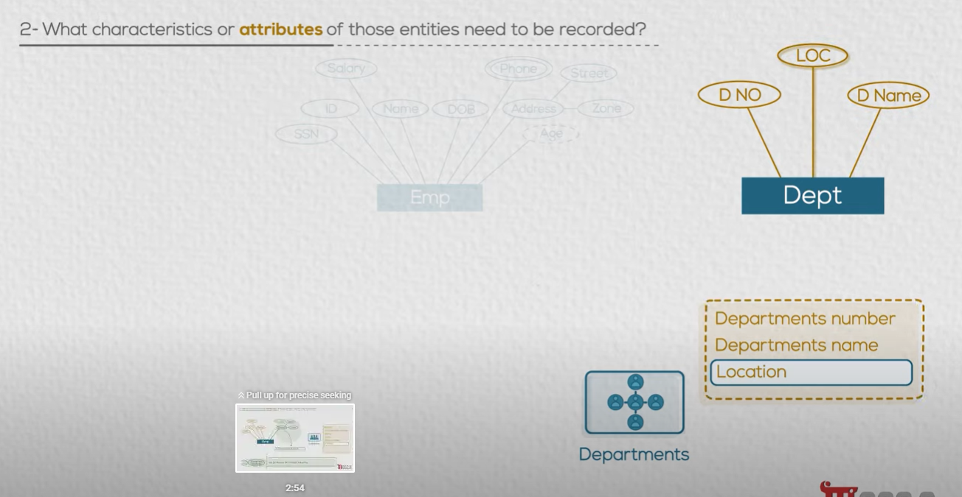


Slide 42
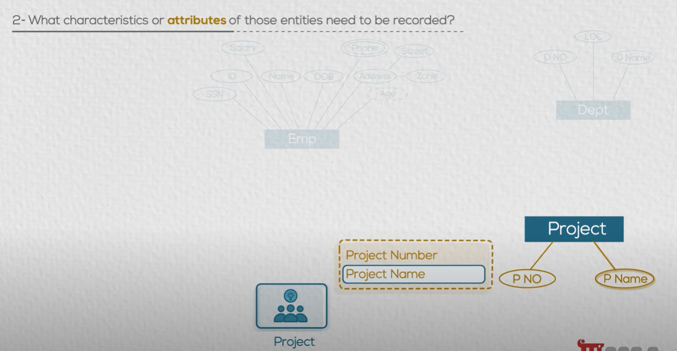

Slide 43
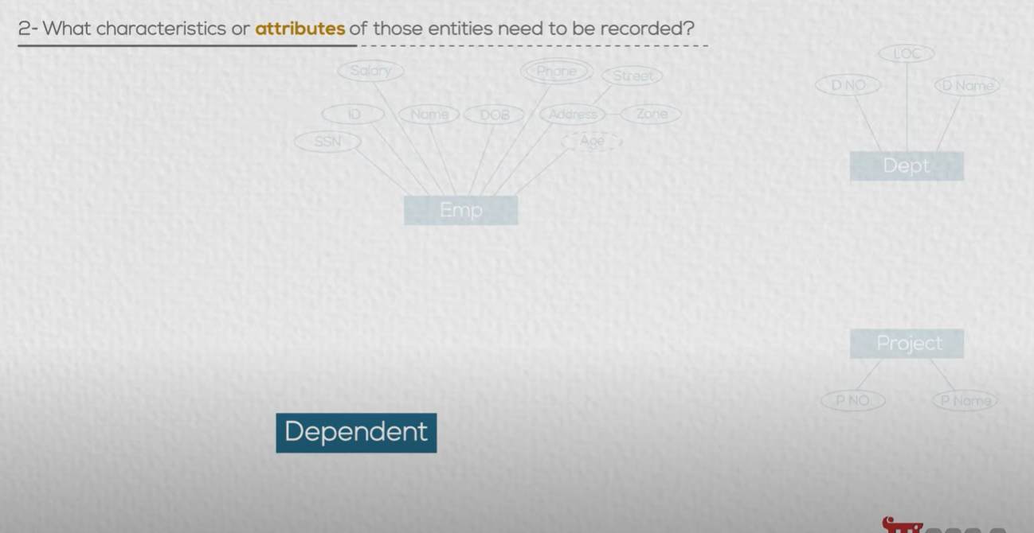
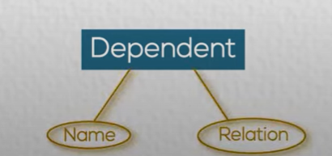
If company has medical coverage for employees Families

Slide 44
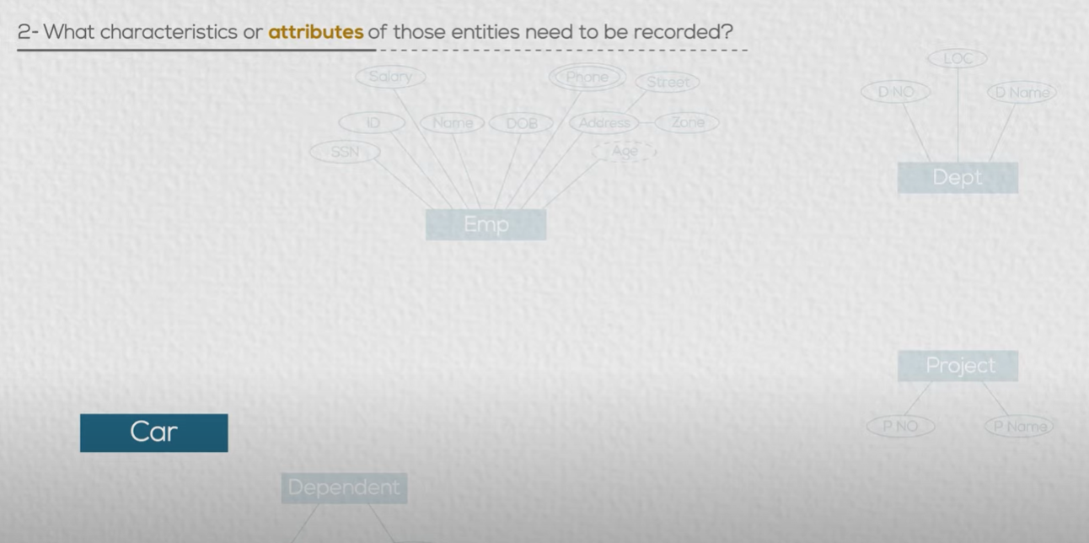
If company wants to record
employees car information

Slide 45
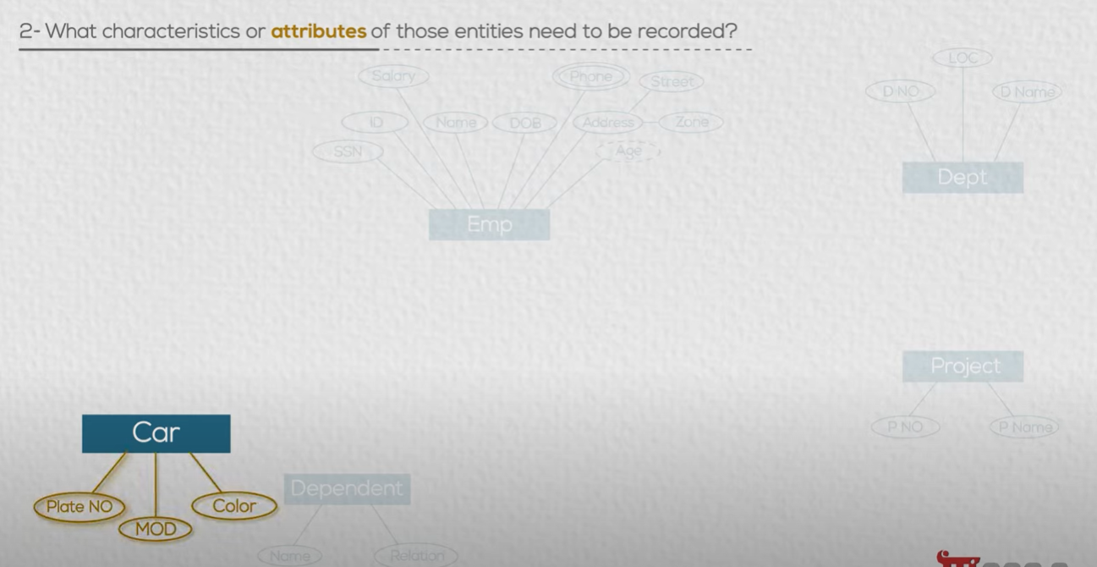

Slide 46
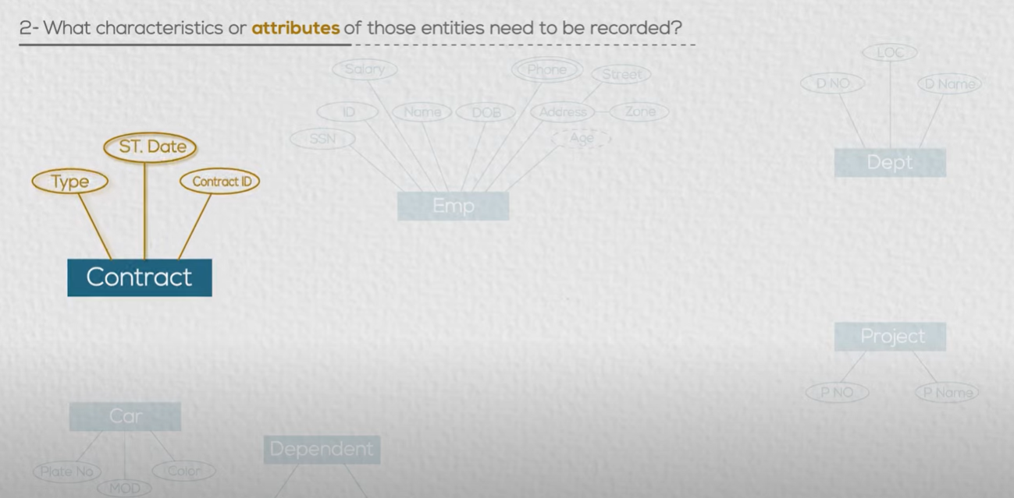

Slide 47
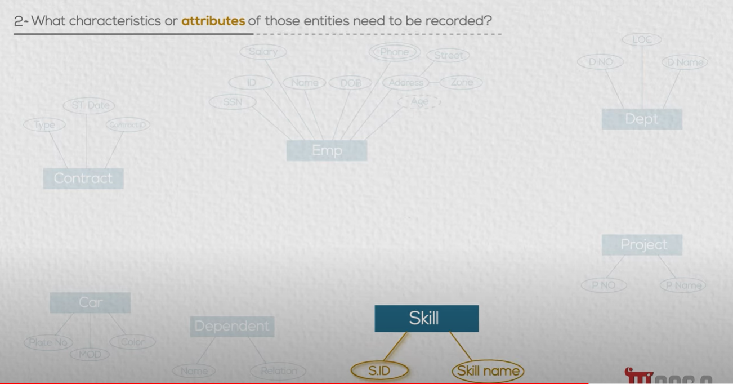

Slide 48
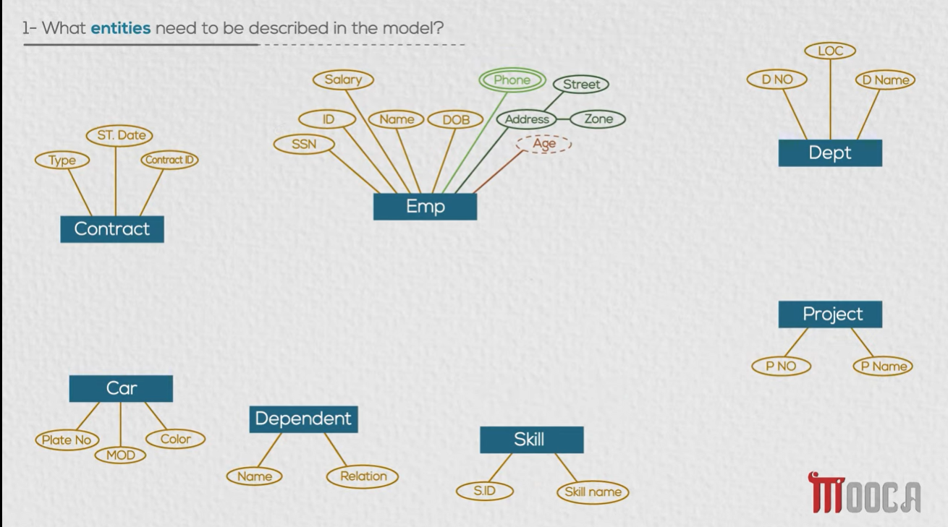

Slide 49
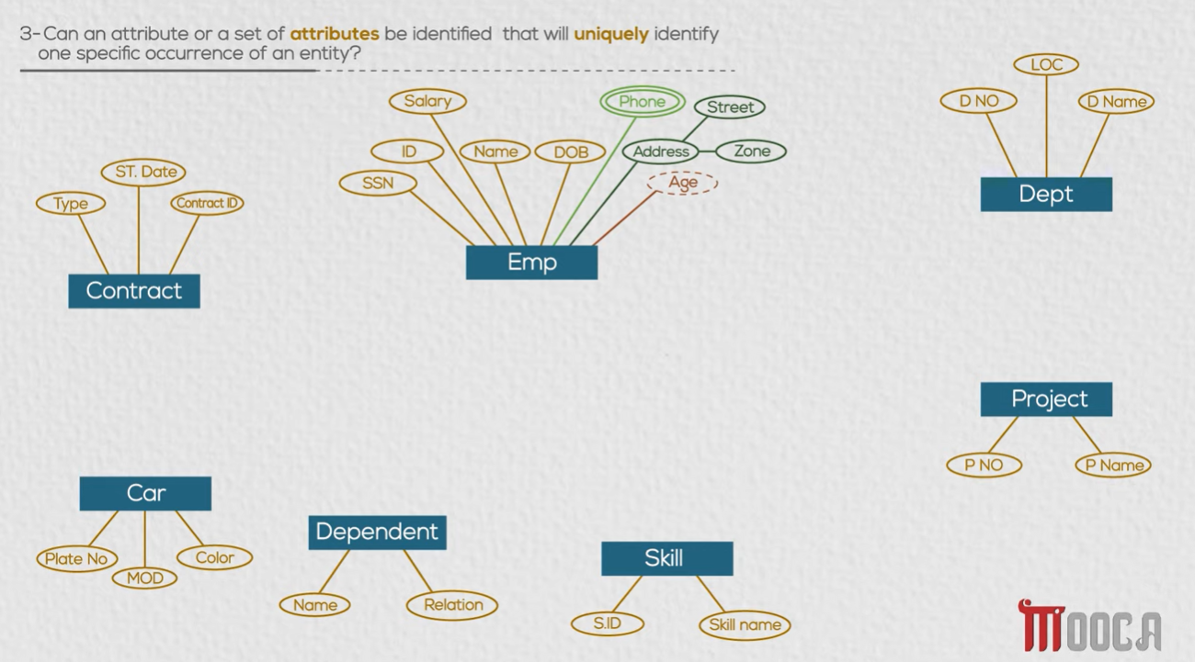

Slide 50
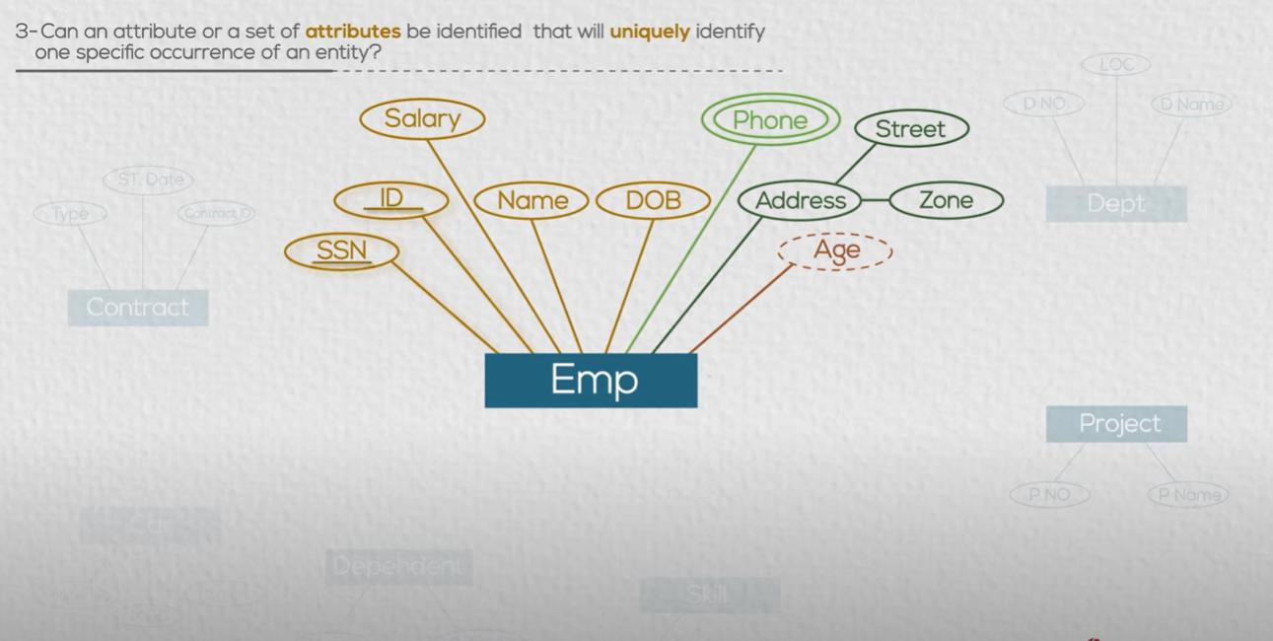
Put underline

Slide 51
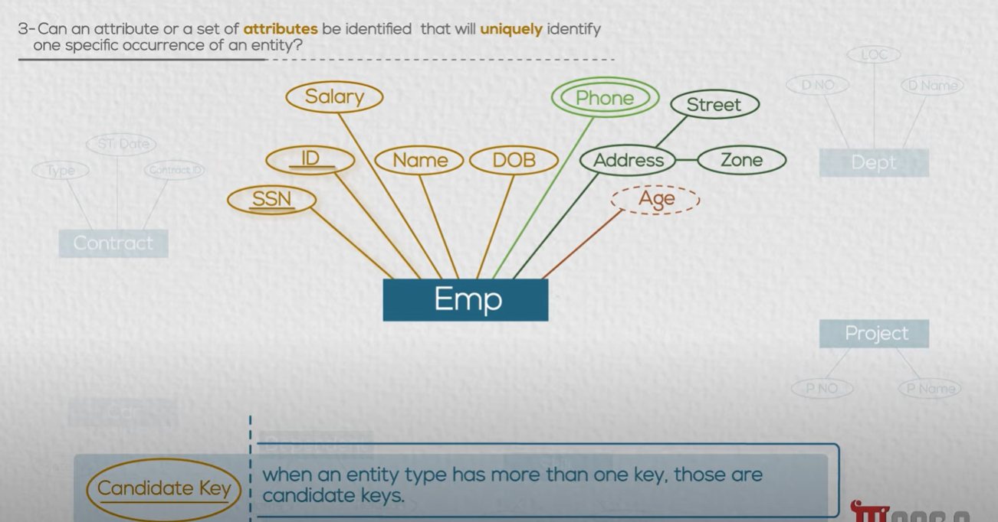

Slide 52
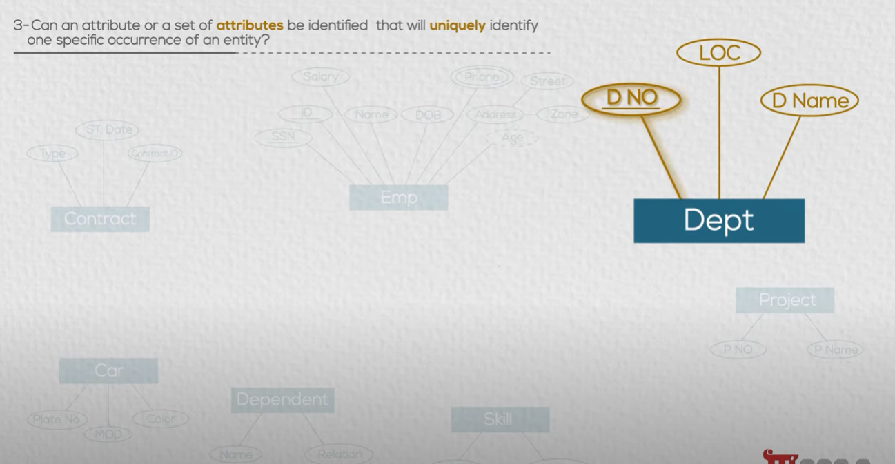

Slide 53
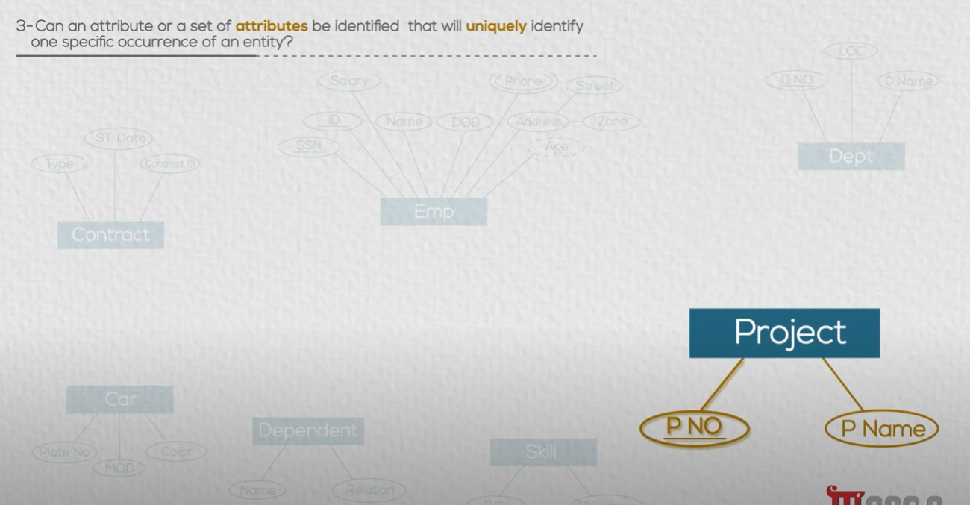

Slide 54
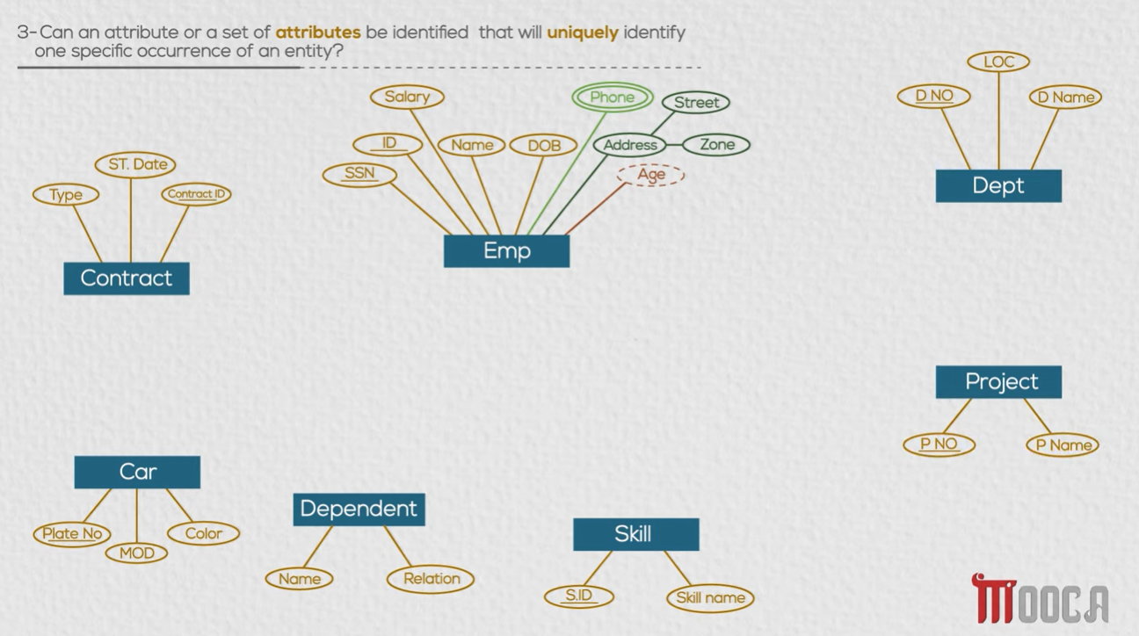

Slide 55


Slide 56


Slide 57


Slide 58


Slide 59


Slide 60

Put double line to identify week identity

Slide 61

Activity 1 : Create your own ERD
Divide Class into groups.
Each group chose a DB project.
Define Entities
Define Attributes
Define Unique Identifiers.

Slide 62


Slide 63
Relationships

Slide 64


Slide 65

I have to define for each relation

Slide 66


Slide 67
Task 4: Define Relationship
Use your previous ERD from Task 3 to define relationships:
Degree of Relationship
Cardinality Ration
Participation

Slide 68


Slide 69



Slide 70


Relation notation
We express using
Verb (work , manage , …)

Slide 71

It is binary
because it is a relation between 2 entities

Slide 72


Slide 73


Employee
has dependance

Slide 74



Slide 75


Slide 76

An employee
supervise another employees

Slide 77


Slide 78



Slide 79


Slide 80


Slide 81

Each employee
joining what project?
using which skills ?

Slide 82



Slide 83


Slide 84


Slide 85


Can an employee
Works in one department?
Or more ?
What is the Business Rule

Slide 86


Department can have one employee?
Or more ?

Slide 87


Can an employee mange one department?
Or more ?

Slide 88


Can a department managed by one employee?
Or more ?

Slide 89

Can an employee work in one project or more ?
Can one project have only one employee or more?

Slide 90


Slide 91


Can an employee manage one employees or many ?
Can an employee have one supervisor or many ?

Slide 92


Can an employee has one dependent or many ?
Can one dependent has many employees or one?

Slide 93

An employee can have one car
A car can only owned by one emploee

Slide 94

An employee can have one contact
A contract can only owned by one employee

Slide 95

What about ternary relationship ?

Slide 96
We assume we have 3 binary relationships
Emp-Project

Slide 97

An employee can have many skills to use in projects
Emp-Skill

Slide 98

Project can have many same skills in it (many employees has the same skill)
Skill-Project

Slide 99

An employee has many skills
Emp-Skill

Slide 100

Can the same skill have many employees or only one ?
Emp-Skill

Slide 101

Project can use many skills
And one skill be used in many project
Project-Skill

Slide 102



Cardinality should be identical on the same side
If not
X
You have to change the design

Slide 103



Slide 104


Slide 105


Slide 106

What is the Business Rule
An employee must work in a department
A department may have employees or not

Slide 107
What is the Business Rule
An employee may manage a department
A department must have a manager

Slide 108

What is the Business Rule
An employee may work in a project
A project may have employees

Slide 109

What is the Business Rule
Owner Entity
An employee may has dependent
A dependent must have employee
Always must
Depends on
Weak Entity

Slide 110

What is the Business Rule
An employee may supervise employees (1 side)
An employee May have manager (M side) (CEO has no manager)

Slide 111

What is the Business Rule
An employee may own a car
A Car May be owned by an employee in Garage
(Cars of company may exist in Garage)

Slide 112

What is the Business Rule
An employee must have a contract
Every contract must be belonged to an employee

Slide 113

What is the Business Rule
A project must have an employee with specific skill.
A skill must be used by an employee in a project .
An employee must use a skill in a project.

Slide 114

Identifying relationship :
It is the relation between weak and owner entity.
We distinguish it with double line

Slide 115


An attribute in relationship:
What if I want to trace :when did the employee start MANAGE the department ?
Where to put the attribute ?

Slide 116

An attribute in relationship:
I can put on employee entity.
But this mean it is the start date of the employee in company

Slide 117

An attribute in relationship:
I can put on Department entity.
But this mean it is the start of the department.

Slide 118

An attribute in relationship:
I should put on the relationship itself.
This mean that is when the employee started to mange the department.

Slide 119

An attribute in relationship:
The same way if I want to record hours the employee worked in the project.

Slide 120
Activity 2 : Define Relationships
Divide Class into groups.
Each group complete its chosen DB project.
Define Relationships:
Degree of Relationship
Cardinality Ration
Participation

Slide 121


Said Fawzy

